Slide 1

Cloud-Based Identity and Access Management System with Federated Authentication
CSA1522 - CLOUD COMPUTING AND BIG DATA ANALYTICS
Presented By:
DHILIBAN M (19241166)
MADHAN R(192324256) BUVANESH Y(192372367)
Supervisor:
DR.P. RAJARAM

Slide 2


INTRODUCTION
Modern organizations face increasing challenges in managing user identities securely across multiple cloud applications.
Federated authentication using standards like OAuth2 and SAML enables seamless identity federation across diverse platforms.
Single Sign‑On provides a unified login experience that reduces user friction, improves productivity, and strengthens security.
Centralized policy enforcement with role‑based access control and audit logging ensures compliance and accountability.
This project aims to deliver a cloud‑based Identity and Access Management solution that integrates credential management, federated SSO, and policy enforcement for secure enterprise adoption.

Slide 3
OBJECTIVE
To design and implement a secure cloud‑based Identity and Access Management (IAM) system supporting federated authentication.
To enable seamless Single Sign‑On (SSO) across multiple cloud‑hosted applications using OAuth2 and SAML standards.
To integrate user identity and credential management with platforms like Keycloak and Firebase Auth for scalability and reliability.
To enforce centralized access policies through Role‑Based Access Control (RBAC) and maintain comprehensive audit logs.

Slide 4
EXISTING SYSTEM
Many organizations currently rely on basic IAM solutions that provide user credential storage and authentication but lack advanced federation features.
Traditional systems often implement standalone Single Sign‑On (SSO) within limited applications, without true cross‑platform federation across multiple cloud services.
Access control is usually role‑based but decentralized, with policies managed separately in each application, leading to inconsistencies and administrative overhead.
Audit logging and compliance tracking are often minimal, making it difficult to ensure accountability and meet regulatory requirements.
Current solutions may not fully integrate modern standards like OAuth2 and SAML, resulting in reduced scalability, interoperability issues, and higher security risks.

Slide 5
PROPOSED SYSTEM
A cloud‑based Identity and Access Management (IAM) platform that integrates OAuth2 and SAML protocols to provide secure federated authentication across multiple applications.
Centralized user identity and credential management using Keycloak or Firebase Auth, ensuring scalability, reliability, and simplified administration.
Seamless Single Sign‑On (SSO) experience allowing users to authenticate once and access multiple federated cloud services without repeated logins.
Role‑Based Access Control (RBAC) with centralized policy enforcement to ensure consistent authorization and compliance across all applications.
Comprehensive audit logging and monitoring to track authentication events, policy enforcement actions, and system activity for accountability and regulatory compliance.

Slide 6
METHODOLOGY
Adopt an Agile Software Development Life Cycle (SDLC) approach, breaking the project into iterative sprints for design, implementation, testing, and evaluation.
Use Keycloak/Firebase Auth for identity and credential management, integrating OAuth2 and SAML protocols to enable federated authentication.
Implement Federated Single Sign‑On (SSO) by configuring trust relationships between cloud‑hosted applications and the IAM system.
Apply Role‑Based Access Control (RBAC) for centralized policy enforcement, ensuring secure authorization across all federated services.
Conduct system evaluation and testing using defined metrics such as authentication success rate, login latency, token validation accuracy, and audit log completeness.

Slide 7
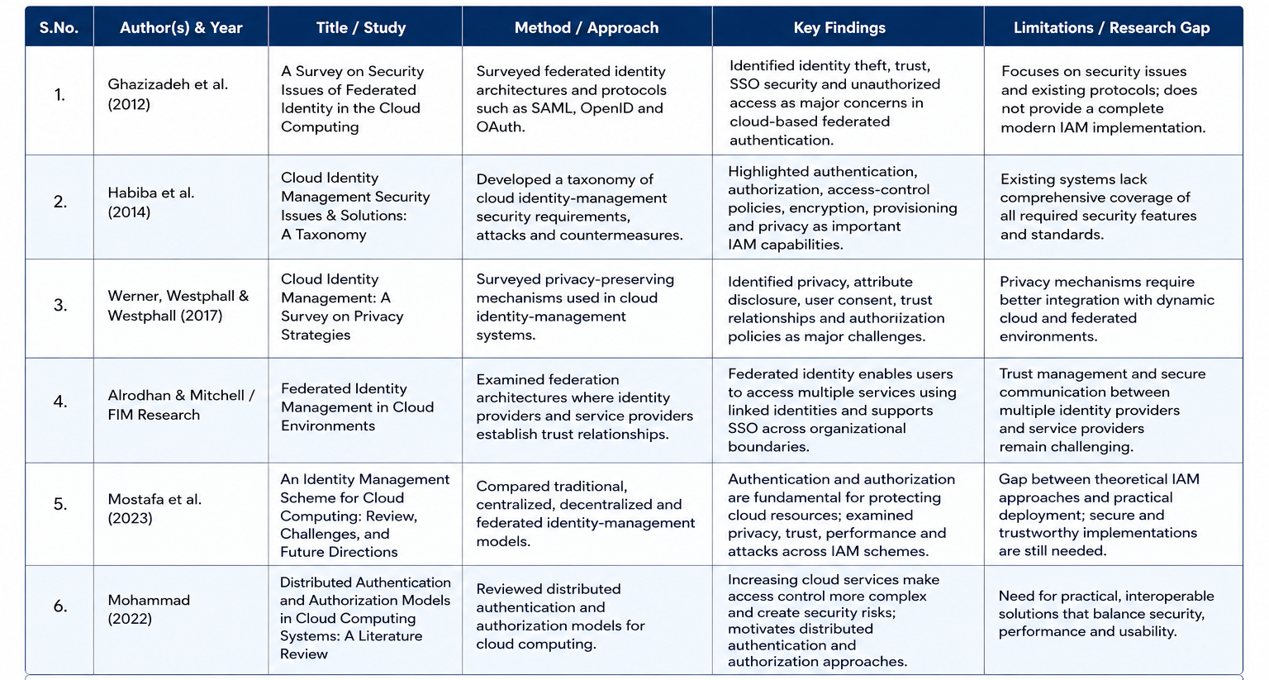
LITERATURE REVIEW

Slide 8
Module 1: User Identity & Credential Management
Provides secure user registration and credential storage in a cloud database.
Uses Keycloak or Firebase Auth for managing identities and issuing tokens.
Supports OAuth2 and SAML protocols for federated authentication.
Ensures scalability and reliability for large user bases.
Maintains centralized identity records to simplify administration.

Slide 9
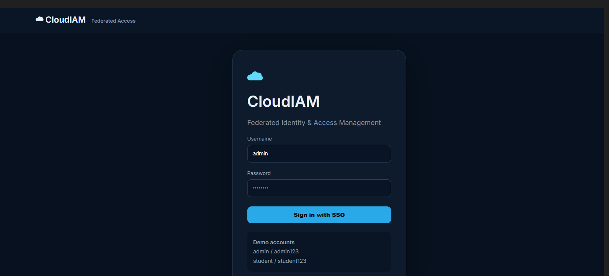
Module 1: OUTPUT

Slide 10
Module 2: Federated Single Sign‑On (SSO)
Allows users to authenticate once and access multiple cloud applications seamlessly.
Establishes trust relationships between federated services using OAuth2/SAML.
Reduces login friction and improves user productivity.
Manages session tokens across applications for consistent access.
Provides a unified login experience across diverse platforms.

Slide 11
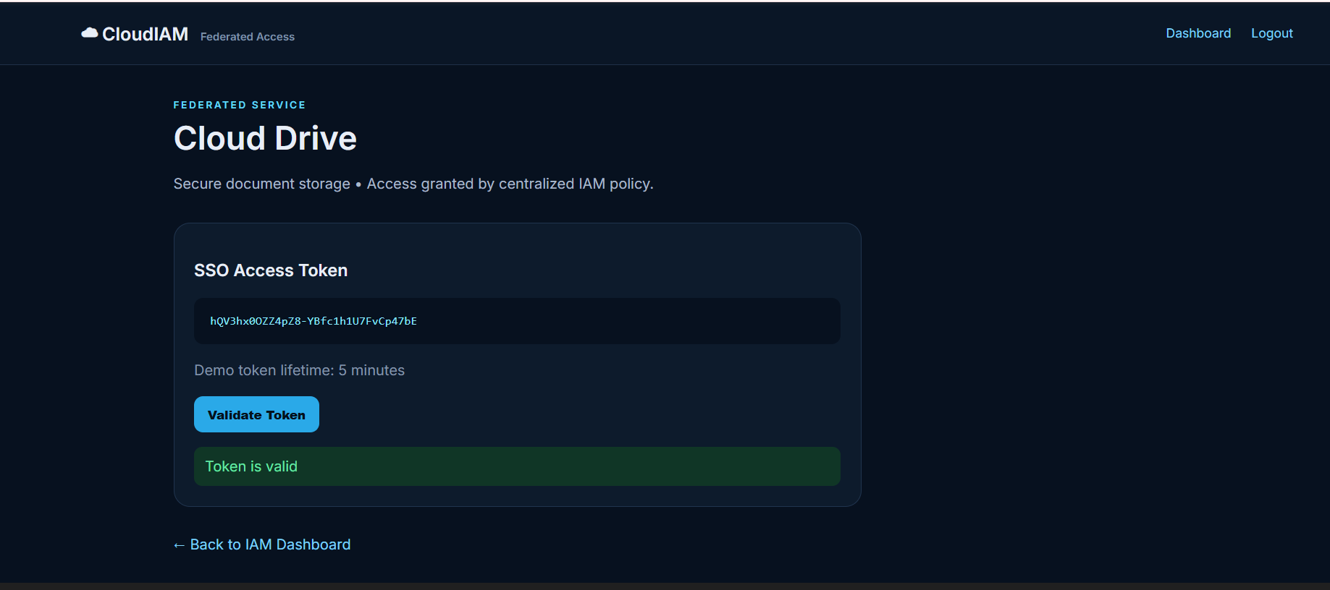
Module 2: OUTPUT

Slide 12
Module 3: Access Policy Enforcement & Audit Logging
Implements Role‑Based Access Control (RBAC) for centralized authorization.
Enforces consistent security policies across all federated applications.
Tracks authentication and access events in detailed audit logs.
Supports compliance monitoring and accountability for organizations.
Provides insights into system activity for performance and security evaluation.

Slide 13
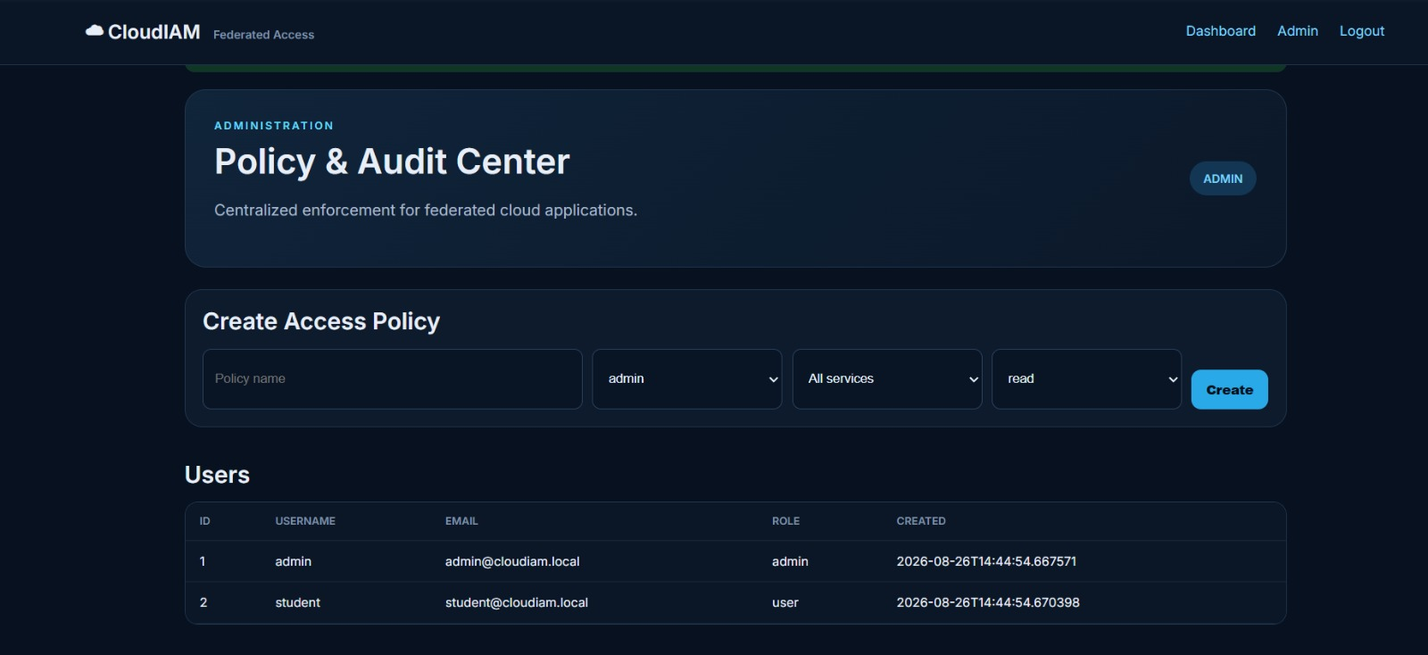
Module 3: OUTPUT

Slide 14
CONCLUSION
The proposed system successfully integrates federated authentication using OAuth2 and SAML to provide secure identity management.
Centralized credential handling with Keycloak/Firebase Auth ensures scalability, reliability, and simplified administration.
Single Sign‑On enhances user experience by reducing login friction and enabling seamless access across multiple cloud applications.
Role‑Based Access Control and audit logging strengthen compliance, accountability, and overall system security.
The project demonstrates a robust, cloud‑based IAM solution that addresses existing limitations and delivers a secure, efficient, and scalable framework for enterprise adoption.

Slide 15
REFERNCES
T. Lodderstedt, J. Bradley, A. Labunets, and D. Fett, “RFC 9700: Best Current Practice for OAuth 2.0 Security,” Internet Engineering Task Force (IETF), Jan. 2025. doi: 10.17487/RFC9700.
D. Fett, B. Campbell, J. Bradley, T. Lodderstedt, M. Jones, and D. Waite, “RFC 9449: OAuth 2.0 Demonstrating Proof of Possession (DPoP),” Internet Engineering Task Force (IETF), Sep. 2023. doi: 10.17487/RFC9449.
T. Lodderstedt, J. Richer, and B. Campbell, “RFC 9396: OAuth 2.0 Rich Authorization Requests,” Internet Engineering Task Force (IETF), May 2023. doi: 10.17487/RFC9396.
R. Hedberg, M. B. Jones, A. Å. Solberg, J. Bradley, G. De Marco, and V. Dzhuvinov, “OpenID Federation 1.0,” OpenID Foundation, Feb. 2026.
N. Sakimura, J. Bradley, M. Jones, B. de Medeiros, and M. Mortimore, “OpenID Connect Core 1.0 incorporating errata set 2,” OpenID Foundation, Dec. 2023.

Slide 16
Thanks!!!

